Slide 1
Storyboard

Slide 2
Create a Storyboard
After we have the user’s needs we can create storyboards.
Don’t focus on interface yet.
Storyboard helps you focus on task first.
Good storyboard will have an actual person. Like a comic strip.
You don’t need to know how to draw! It’s about communicating ideas.

Slide 3
Storyboard Origin
Origin of the storyboard is in the film industry:
One panel = One Scene
Presented to a group of people
Gauge their reactions, understanding
Notes:
Pic from http://screencrush.com/movie-storyboards/

Slide 4
Storyboard, cont.
Graphical depiction of the appearance of the intended system, without system functionality.
Provide a mechanism to gracefully move from conceptual design to screen design
Intended to visualize our scenarios
Allow us to make mistakes early, in paper (cheap and quick), instead of later, in software (expensive and mind-numbing)

Slide 5
Key Elements for Storyboard
#1 Images or illustrations.
#2 Scene descriptions. ...
#3 Shot sequences. ...
#4 Timing information. ...
#5 Notes and annotations.

Slide 6
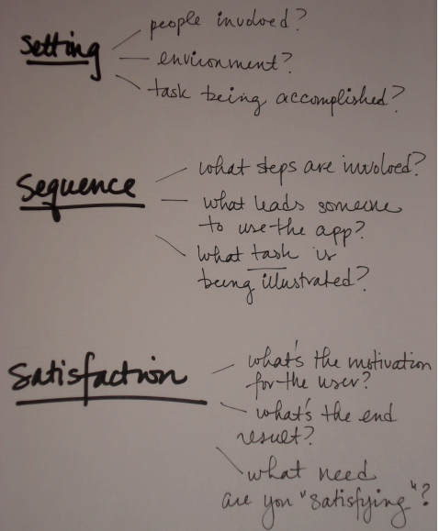
Setting / Sequence / Satisfaction
http://spark-public.s3.amazonaws.com/hci/assignment_ressources/assignment3_storyboard_notes.pdf

Slide 7
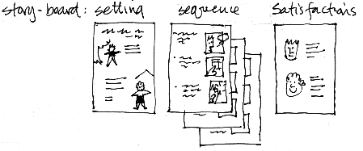
Storyboard: Setting, Sequence, Satisfaction

Slide 8
Time limit
Storyboard: Have a 10 minute time limit. It doesn’t need to be beautiful. Just an idea.

Slide 9
Storyboard Example
“Sharing resumes and other professional documents can be difficult, particularly at career fairs, where you frequently run out and have to deal with the hassle of printing dozens of hard copies. This app seeks to provide a simple way of sharing your documents with other professionals. We want to make it easier for both the applicant and the employer to keep track of professional documents and share things in an intuitive environmentally friendly.”
See: http://d.ucsd.edu/class/intro-hci/2015/assignments/examples/a03example2.html

Slide 10
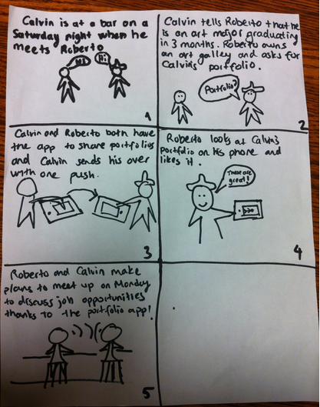
Storyboard Examples
http://d.ucsd.edu/class/intro-hci/2015/assignments/examples/a03example2.html

Slide 11
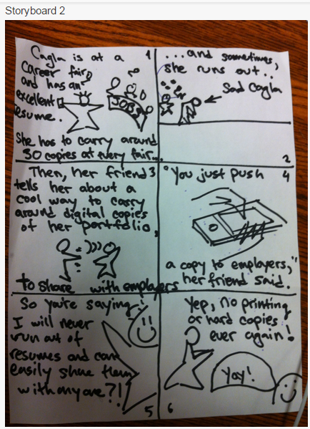
Second Storyboard
http://d.ucsd.edu/class/intro-hci/2015/assignments/examples/a03example2.html

Slide 12
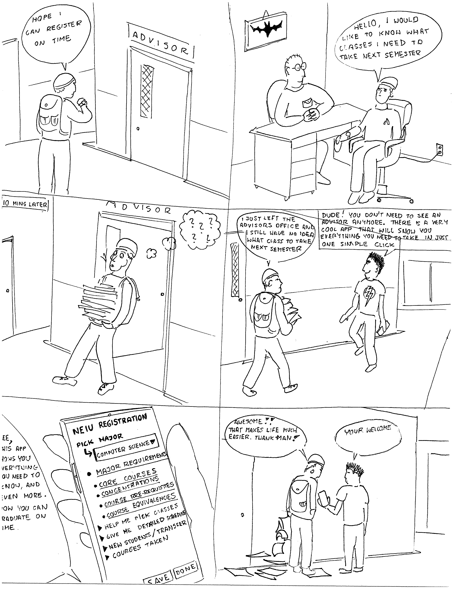
Student Example

Slide 13
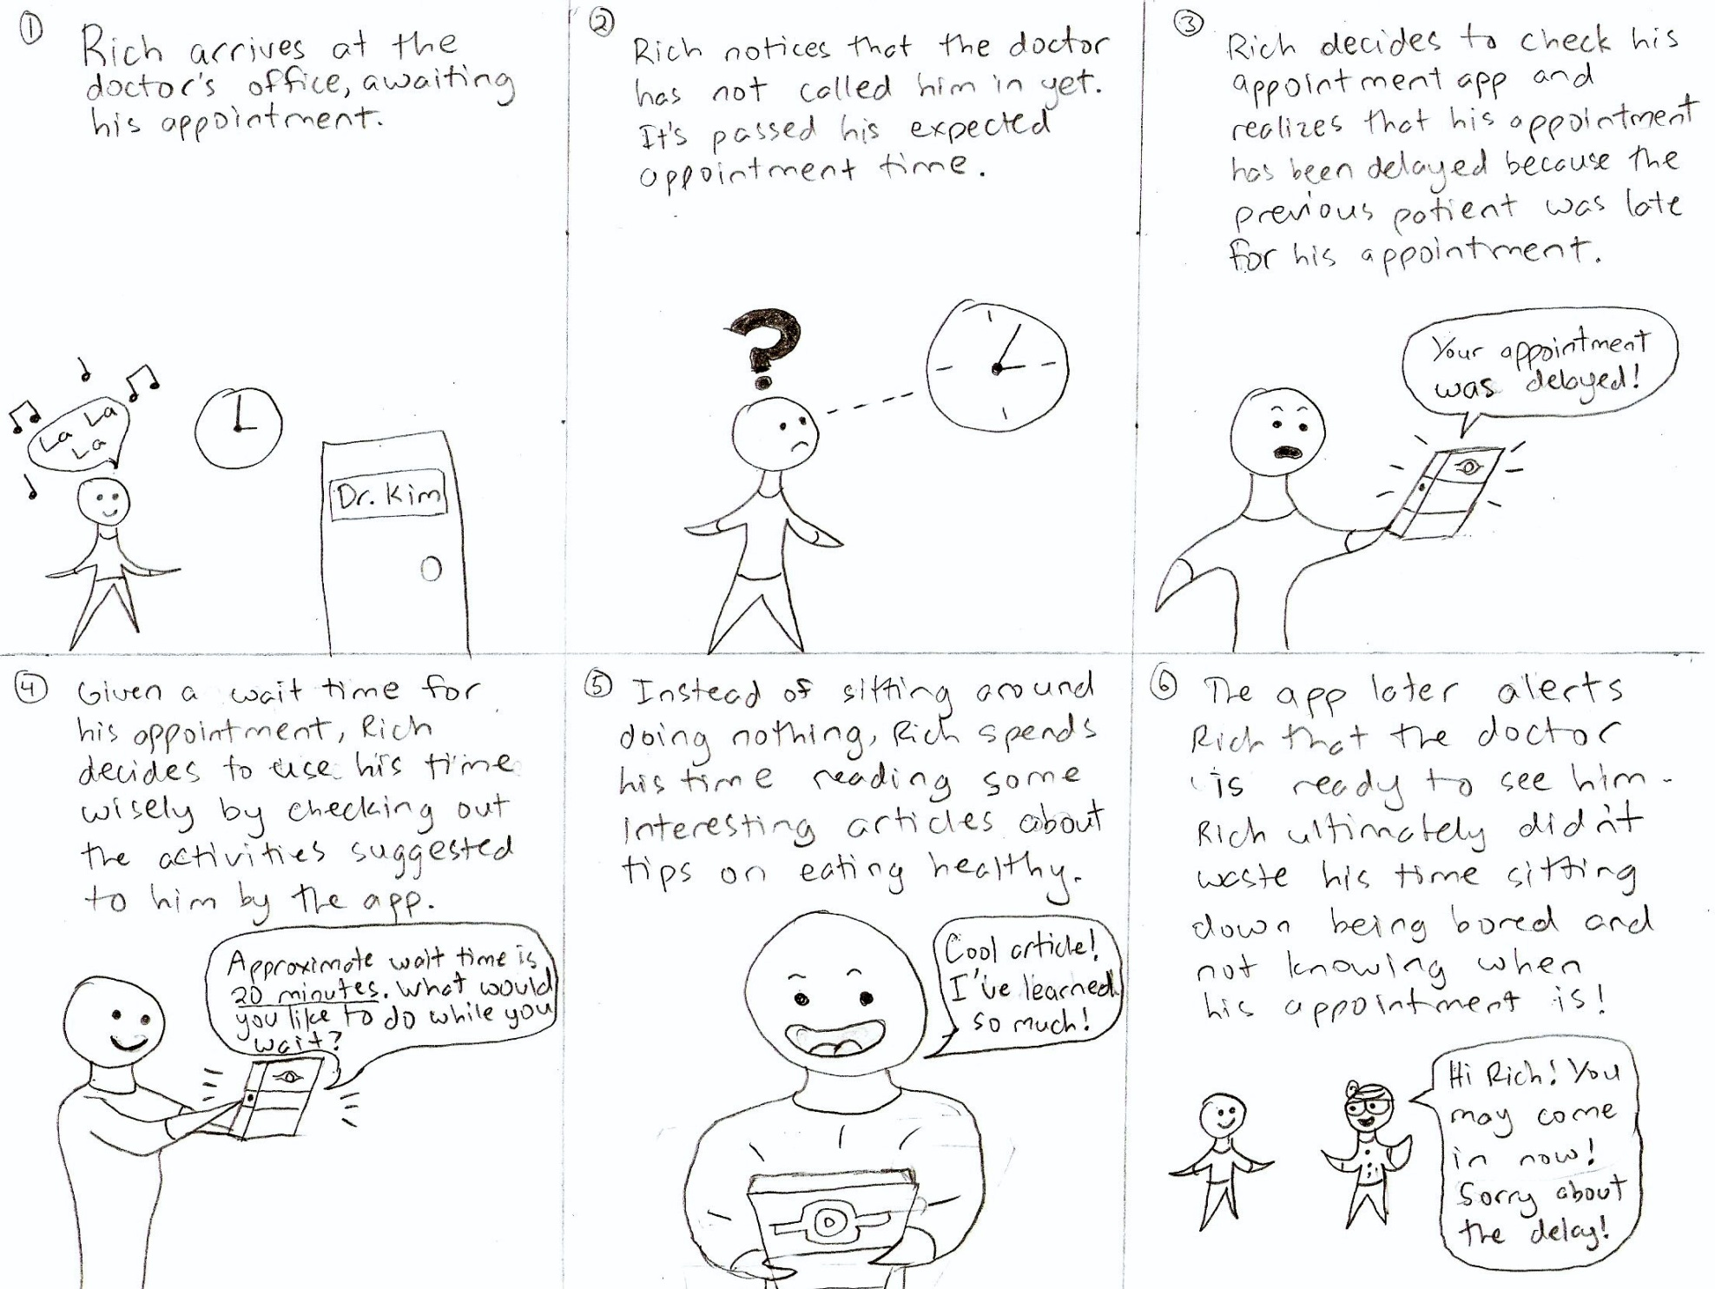
Another Student Example

